Slide 1







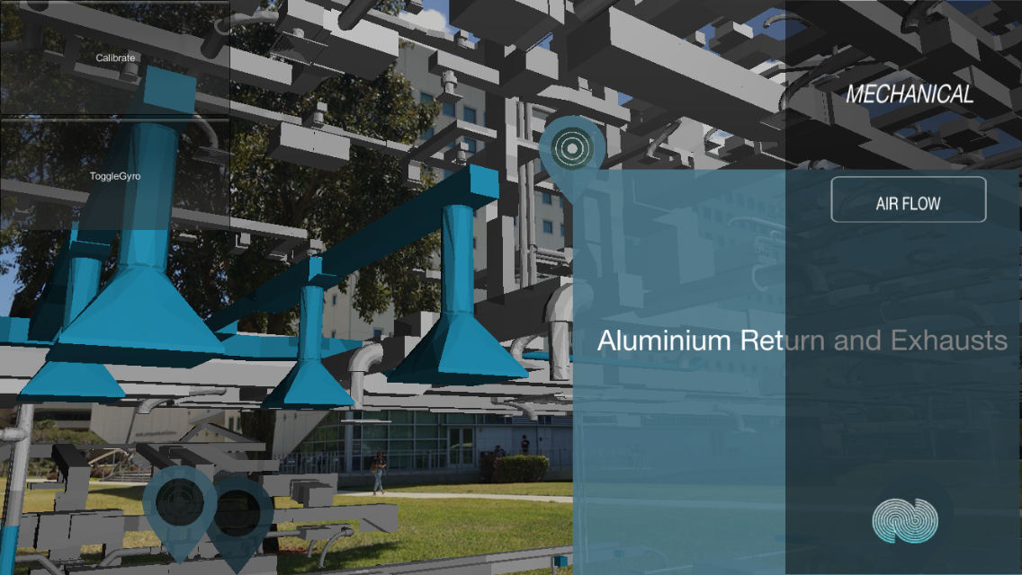
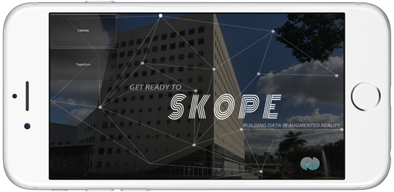
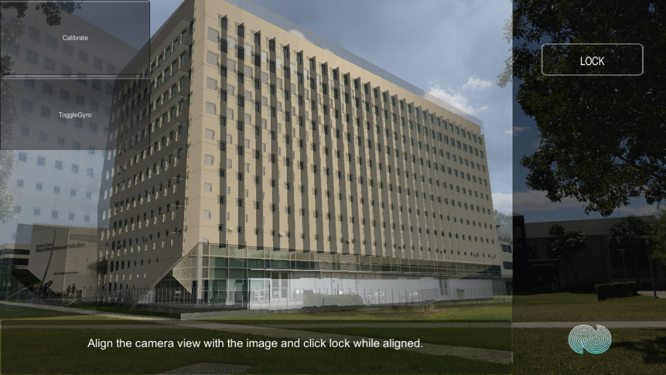
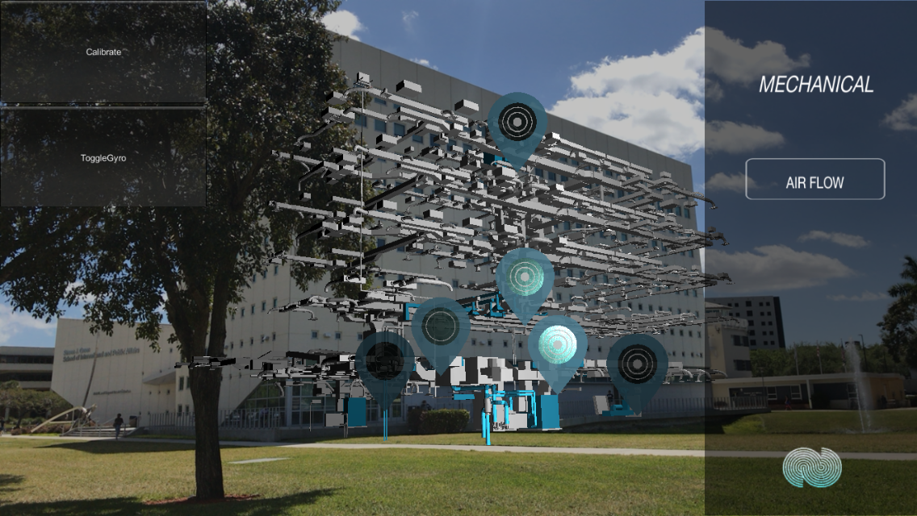
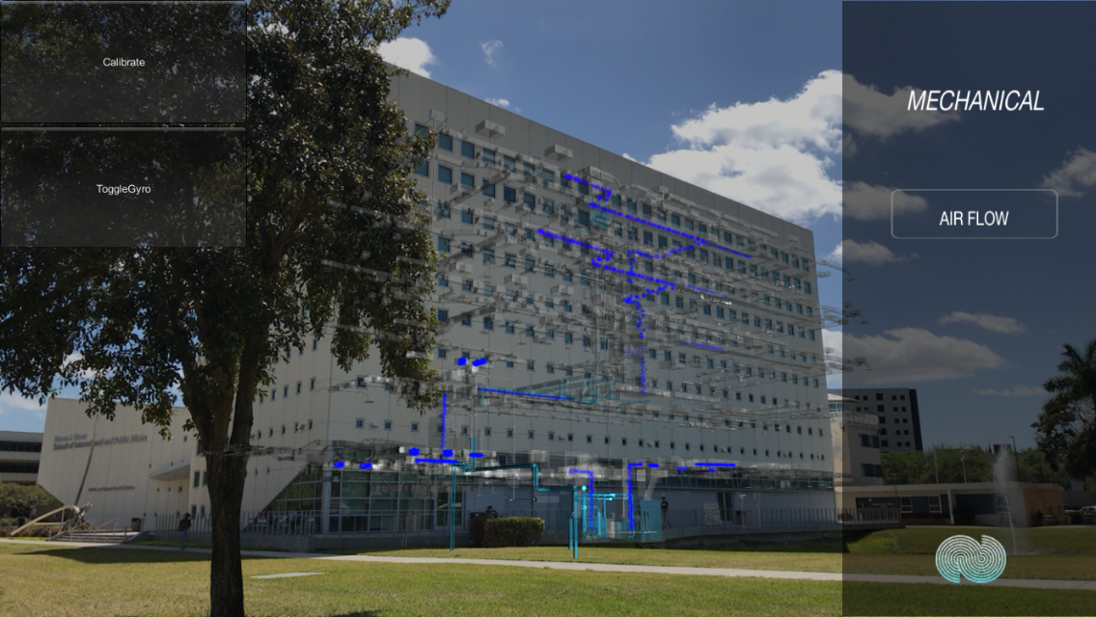
Senior Project, 2017, Spring
Learning With Augmented Reality
Student: Jeffrey Perez, Florida International University
Mentor: Mohsen Taheri, Dr. Francisco Ortega, Dr. Shahin Vassigh, Florida International University
Instructor: Dr. Masoud Sadjadi, Dr. Shahin Vassigh, Florida International University
Problem
How to implement various functionality based on the user’s interaction?
How to produce a panel that changes the displayed info and diagram?
How to create user friendly SKOPE-AR application for Android deployment?
Solution
A state machine was implemented to handle the panel description and user input
The information of the description panels are stored in a text file we created
After implementation and testing, a build was generated in Unity and uploaded to the Google Play Store
Current System
User opens SKOPE-AR
Taps the SKOPE button
A brief description of how to use the program is displayed
User taps their location via the panels
User then aligns the camera and locks
User interacts with application via panels and the 3D model
Object Design
System Design
SKOPE AR uses a three-tier architecture.
Presentation Tier: iOS/Android applications
Application Tier: Unity GameObject consists of all the C# scripts that control the application
Data Tier: Text file holding the description for each panel.
Implementation
Implementation framework:
Microsoft Visual Studio
Graphic Modeling:
Unity Game Engine
Summary
SKOPE-AR provides a model with information of the SIPA building in order to help the Architecture Department teach core building science concepts. The application enhances learning by showing description and videos of specific design and construction aspects of the building. The latest version of SKOPE-AR is already available for both Android and iOS devices.
Verification
SKOPE-AR is currently undergoing development and a few of the user stories have been tested using:
Unit Testing
Rainy Day Test
Sunny Day Test
Requirements
Mobile:
Android 4.4 or newer
iOS 6.0 or newer
Camera
Gyroscope
Screenshots
Acknowledgement
The material presented in this poster is based upon the work supported by Jeffrey Perez I am thankful to the help that I received from my group members, Luis Perera, my mentor, instructors, Shahin Vassigh, and the amazing SKOPE team: Albert Elias, Hadi Alhaffar, and Gio Gallardo.
Notes:
1

